Slide 1



SHIELD INSURANCE
A Project by: Aditya ansuman Routray
PILOT STUDY:
INSIGHTS INTO CUSTOMER BEHAVIOR AND REVENUE TRENDS OVER TIME USING SALES MODE AND AGE GROUP

Slide 2

COURSE OF ACTION
CITY
PROBLEM
STATEMENT
INSIGHTS
RECOMMENDATIONS
TIME PERIOD
DATA
EXPLORATION
PROPOSED ENHANCEMENT FOR FULL_SCALE_IMPLEMENTATION
SALES MODE
DASHBOARD
AGE GROUP
IMPLEMENTATION PLAN & TIMELINE
INSIGHTS & RECOMMENDATIONS
POLICY
FUTURE SCOPE
& FULL SCALE IMPLEMENTATION
BENEFIT & BUSINESS IMPACT

Slide 3
PROBLEM STATEMENT
DATA EXPLORATION
“SHIELD INSURANCE FACES CHALLENGES IN DELIVERING IMPROVED CUSTOMER SOLUTIONS WHILE EXPANDING ITS CUSTOMER BASE ACROSS INDIAN CITIES. THE COMPANY NEEDS TO IDENTIFY EFFECTIVE STRATEGIES TO INCREASE CUSTOMER ACQUISITION AND REVENUE GROWTH”

Slide 4
CITY
DATA EXPLORATION
DELHI
INDORE
MUMBAI
CHENNAI
HYDERABAD

Slide 5
TIME PERIOD
DATA EXPLORATION
NOVEMBER_2022
DECEMBER_2022
JANUARY_2023
FEBRUARY_2023
MARCH_2023
APRIL_2023

Slide 6
SALES MODE
DATA EXPLORATION
APP
ONLINE
WEBSITE
DIRECT
OFFLINE
AGENTS

Slide 7
AGE GROUP
DATA EXPLORATION
[18-24]
[25-30]
[31-40]
[41-50]
[51-65]
[65+]

Slide 8
POLICY
DATA EXPLORATION
POLICY ID | BASE COVERAGE AMT(INR) | BASE PREMIUM AMOUNT(INR)
POL4321HEL | 200000 | 5000
POL4331HEL | 300000 | 7500
POL3309HEL | 500000 | 12000
POL5319HEL | 750000 | 16700
POL6303HEL | 1000000 | 21500
POL6093HEL | 1500000 | 31700
POL9221HEL | 2500000 | 42500
POL1048HEL | 5000000 | 76500
POL2005HEL | 10000000 | 120000

Slide 9
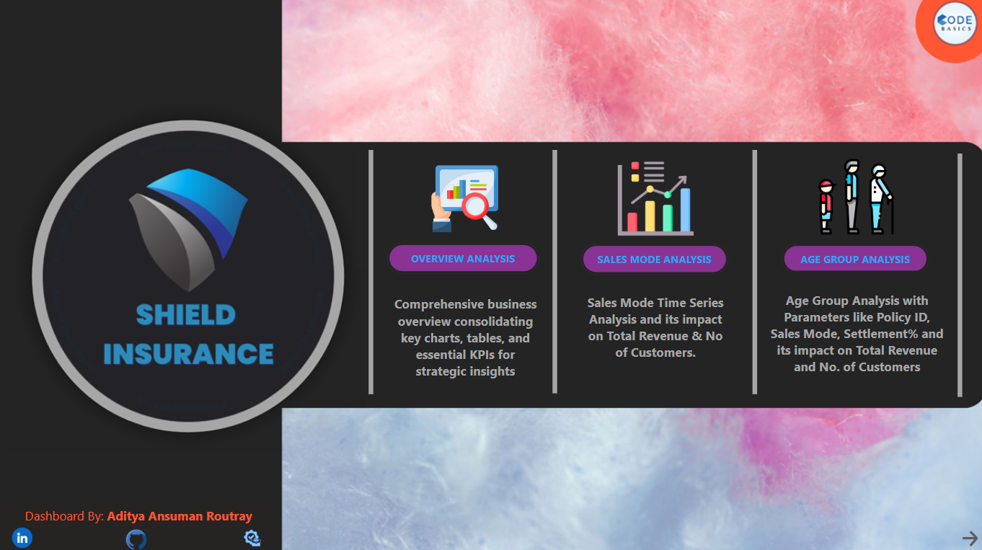

Slide 10
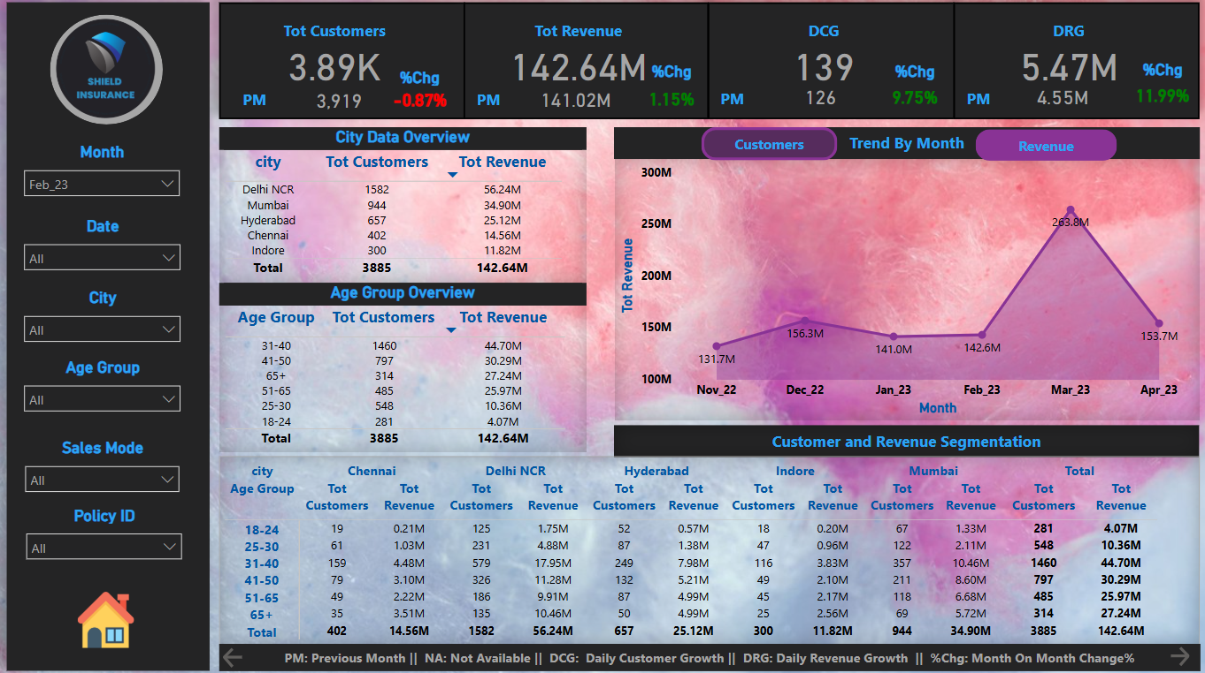

Slide 11
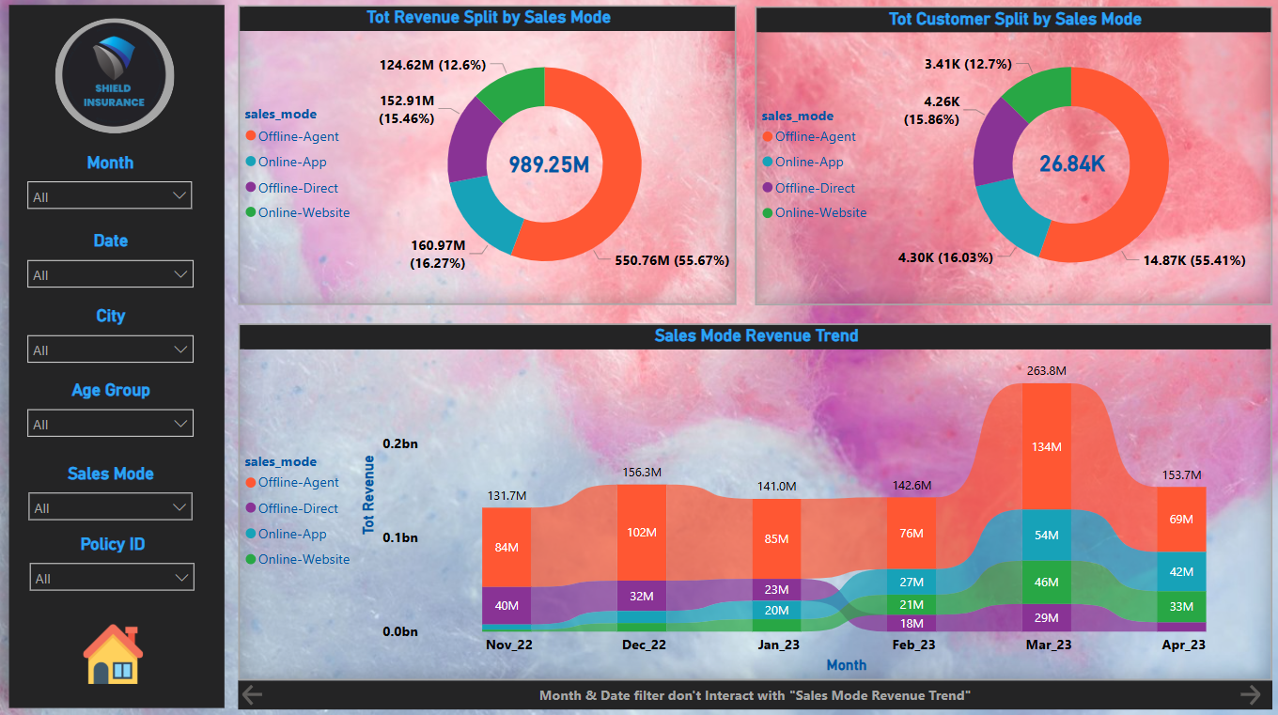

Slide 12
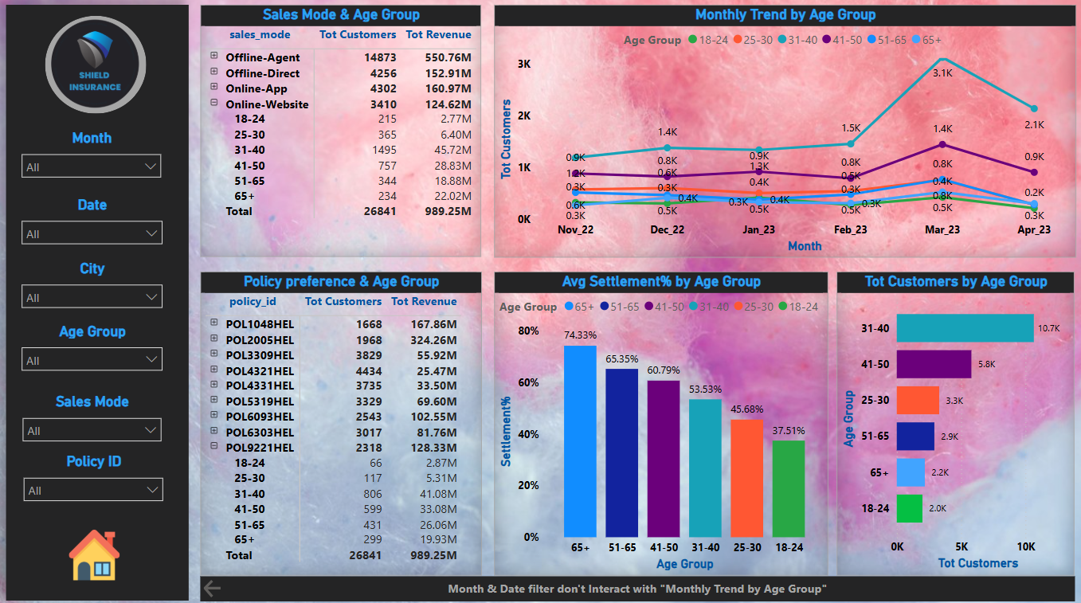

Slide 13
INSIGHTS & RECOMMENDATIONS
POSITIVE CORRELATION BETWEEN TOTAL CUSTOMERS AND REVENUE FOR ALL MONTHS BUT FEB_23(CUSTOMERS 7081 REVENUE 263.84M)
SETTLEMENT% INCREASES WITH AGE WITH HIGHEST BEING 74.33% FOR 65+ AGE GROUP CUSTOMERS.
 | CITY | AGE GR | POLICY ID | SALES MODE
HIGHEST REVENUE | DELHI 401.57M | [31-40] 320.6M | POL2005HEL 324.26M | AGENT 550.76M
LOWEST REVENUE | INDORE 81.35M | [18-24] 27.33M | POL4321HEL 25.47M | WEBSITE 124.62M
HIGHEST CUSTOMERS | DELHI 11007 | [31-40] 10652 | POL4321HEL 4434 | AGENT 14873
LOWEST CUSTOMERS | INDORE 2096 | [18-24] 1994 | POL1048HEL 1668 | WEBSITE 3410
INSIGHTS

Slide 14
INSIGHTS & RECOMMENDATIONS
FOCUS ON HIGH VALUE AGE GROUP [31-40] WITH SPECIAL PLANS
ACQUIRE [18-24] AGE GROUP CUSTOMERS WITH AFFORDABLE PLANS THROUGH EDUCATIONAL CAMPAIGNS
ENHANCE INCENTIVES FOR OFFLINE AGENTS TO ENCOURAGE HIGHER ENGAGEMENT AND PRIORITIZE YOUR PRODUCTS OVER COMPETITORS
CREATE A BETTER USER INTERFACE IN THE ONLINE APP & WEBSITE
TO INCREASE CUSTOMER BASE ADD NON LIFE INSURANCE PRODUCTS
FOR BIG CITIEY CUSTOMERS ADD ULIP, MF_LIFE INSURANCE COMBO, BODY PART INSURANCE, CYBER INSURANCE
RECOMMENDATIONS

Slide 15
FUTURE SCOPE & FULL SCALE IMPLEMENTATION
INTEGRATE DATA OF ALL BUSINESS UNITS AND DEPARTMENTS INTO A UNIFIED BI PLATFORM
ENSURING CENTRALISED DATA GOVERNANCE
ENSURING SCALABILITY CONSIDERING BUSINESS EXPANSION INTO OTHER CITIES
PROPOSED ENHANCEMENT FOR FULL SCALE IMPLEMENTATION

Slide 16
FUTURE SCOPE & FULL SCALE IMPLEMENTATION
INITIAL ASSESMENT OF CURRENT DATA INFRASTRUCTURE & BUSINESS REQUIREMENT (2 WEEKS)
TOOLS: PowerBI OR MICROSOFT FABRIC( PowerBI+ DATA FACTORY)
DEVELOPMENT OF PLAN WITH CLEAR MILESTONES AND DELIVERABLES (1TO 2 WEEK)
DATA PREPARATION & INTEGRATION (4 TO 6 WEEKS)
DEVELOPMENT AND IMPLEMENTATION (8 TO 12 WEEKS)
TESTING & VALIDATION (2 TO 3 WEEKS)
DEPLOYMENT AND END USER TRAINING (2 TO 4 WEEKS)
INITIAL SUPPORT (6 MONTHS)
ONGOING SUPPORT & MAINTENANCE (TO BE DISCUSSED)
IMPLEMENTATION PLAN & TIMELINE

Slide 17
FUTURE SCOPE & FULL SCALE IMPLEMENTATION
RISK ASSESSMENT & FRAUD DETECTION
CUSTOMER SEGMENTATION & PERSONALIZED PRICING
SALES MODE OPTIMIZATION
EXPANSION & MARKET PENETRATION STRATEGY (ADDITION OF LIFE & NON LIFE INSURANCE TO PRESENT HEALTH INSURANCE)
IMPLEMENT DIFFERENT STRATERGY FOR LIFE & NON LIFE INSURANCE PRODUCTS
CHURN PREDICTION & CUSTOMER RETENTION STRATEGIES
CLAIMS PROCESSING EFFICIENCY & AUTOMATION
POLICY RECOMMENDATIONS & CROSS-SELLING
REVENUE AS WELL AS NET PROFIT INCREASE
BENEFIT & BUSINESS IMPACT

Slide 18
